Slide 1
Factors affecting COVID-19 mortality rate
Vladimir JN Bykov

Slide 2
Selected variables for each available country worldwide
Deaths per 100K
Population density
Education index
Infant mortality
Average yearly temperature
Facial mask wearing custom prior to COVID-19 pandemic, arbitrary values
  0 - no usage
  1 - some
  2 - widespread
Current facial mask usage during pandemic as reported by diferent countries, percent
In total data come from 6 scraped webpages

Slide 3
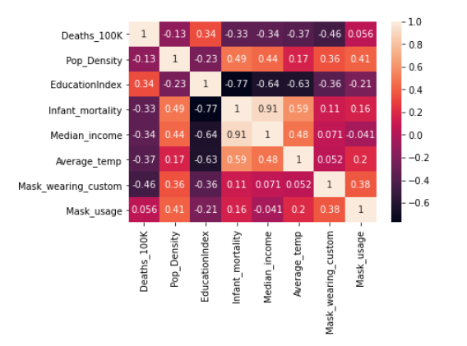
Relationship between variables: correlation matrix

Slide 4
Surprising findings
Population density has no substantial effect on mortality rate
Possible condounding factors: high population density would likely mean high spread of the air-born disease but also more accessible medical help. On the other hand it also means high exposure to wide range of viruses and thus possible cross-immunity.
Infant mortality rate and median income negatively correlated with COVID-19 mortality rate. Both are indicators of powerty. Both mean high exposure to wide range of viruses and thus possible cross-immunity.
Education index positively correlated with COVID-19 mortality rate. Education index is expected to be opposite to powerty indicators thus the effects in our model are opposite as well.

Slide 5
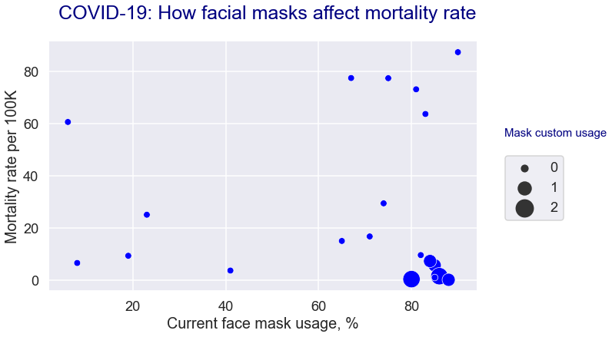
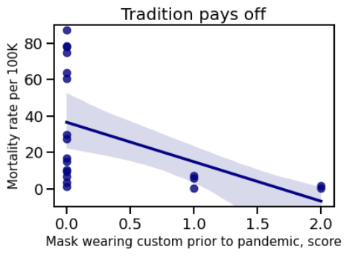
Reported current face mask usage is not the same as a customary habitual usage: different effect on mortality rates
R current mask usage = 0.056, R2 = 0.003, explains 3% of variation
R customary mask usage = -0.46, R2 = 0.21, explains 21% variance in the matrix

Slide 6
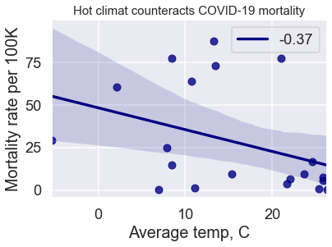
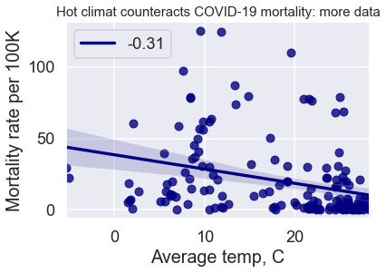
COVID-19 is less deadly in countries with hot climate
There is a temperature zone around 10C which is favourable to COVID-19

Slide 7
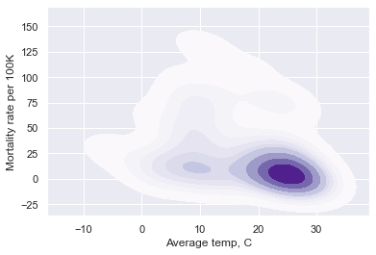
High mortality rates are clustered around 10C average temperature

Slide 8
Most important findings
Traditional and wide spread facial mask usage prior to pandemic is associated with substantially reduced mortality rates
Mask usage in the countries where was no customary facial covering prior to pandemic (seasonal flu, air pollution etc) has no substantial effect on mortality rates
        WHY?
The way one uses and changing mask affects the efficiency of protection, lack of inlearned behaviour, feeling of it being a nuisance

Slide 9
Effectiveness of facial mask agains air-born infections
Mask needs to be changed every two hrs, otherwise breath vapor will compromise its filtering capacity
If using non-single use mask, it shall be sterilize with hot/ boiling water.
Mask can not be taken on and off all the time. If one needs to take it off, it needs to be sterilized even if it means putting it in a plactic bag with hand desinfectant/ alcohol.
It is important not only frequently wash your hands but also wash your face!
And lastly, if one wears a mask it shall cover your mouth and a nose.

Slide 10
Most important findings
High average annual temperature reduce mortality rate of COVID-19
      Does it make sense?
Viruses are not very stable creatures outside of a cell / dropplets
UV-light /sunlight/ is a potent sterilizing agent
High temperature inactivates viruses
Flu-epidemics have a seasonal character and COVID-19 behaves similar to that.

Slide 11

Challenges of the project
Finding suitable website which does accept webscraping
Cleaning data!

Slide 12
Future improvements
Get more data both as epidemiological data and as reading data about population habits in times of air-born epidemics
Estmate strength of each factor/ variable in more precise manner
Take more factors into analysis
Estimate whether there are some underlying factors explaning variation in the data matrix. Likewise ethnic origin, language phonetic character.

Slide 13
Thank you

